Slide 1
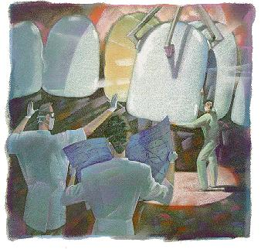
VENEERS / LAMINATES

Slide 2
The patients demand for treatment of unaesthetic anterior teeth is growing steadily.
several treatment options have been proposed to restore the aesthetic appearance of the dentition.
For many years, the most predictable and durable aesthetic correction of anterior teeth has been achieved by the preparation of full crowns.
However, this approach is undoubtedly most invasive with substantial removal of large amount of tooth substance and possible adverse effects on adjacent pulp and periodontal tissues.
In search of more durable aesthetics VENEERS were introduced.

Slide 3
Sturdvent
DEFINITION
Veneer is a layer of tooth colored material that is applied to a tooth to restore a localized or generalized defect and intrinsic discoloration

Slide 4
Treatment is used to improve the appearance of a tooth, which may have been discolored/ damaged by decay / an accident.
The process of applying a thin porcelain or composite resin veneer to a tooth is called LAMINATINIG
Veneers could be fabricated from composite or ceramic.
They could be direct or indirect.

Slide 5
Direct
Indirect
Composite veeners

Slide 6
Direct technique
When only a few teeth are involved or when the entire facial surface is not faulty (i.e., partial veneers), cases involving young children.
Time consuming and labor intensive, sensitive to operator technique.
Economical, single sitting procedure
Composite
Indirect technique
If multiple teeth are to be veneered, indirect veneers usually can be placed much more expeditiously.
Expensive, requires two appointment
More aesthetic, less sensitive to operator technique, lasts much longer than direct veneers
Processed composite, feldspathic porcelain, pressed ceramic

Slide 7
3 BASIC PREPARATION DESIGNS
A window preparation without extension sub-gingivally or involving incisal angle
Window preparation that extends to gingival crest and terminates at the facio-incisal angle
Veneers with incisal overlapping with sub-gingival extension

Slide 8
A window preparation design is recommended for most direct and indirect composite veneers.
Such a preparation, preserves tooth structure, prevent significant occlusal loading and reduced potential for wear of opposing tooth.
An incisal overlapping preparation is indicated when an tooth being restored needs lengthening or when an incisal defect warrants restoration.

Slide 9
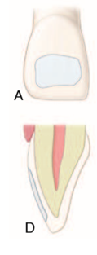
Window Preparation Design
Indications
Advantages
Recommended for indirectly fabricated porcelain veneers in patients who exhibit a canine-guided pattern of lateral guidance.
Preserves the functional lingual and incisal surfaces of maxillary anterior teeth, protecting the veneers from significant occlusal stress.
Reduces the potential for accelerated wear of the opposing tooth

Slide 10
ADVANTAGES
DISADVANTAGES
Esthetics
Veneers is more conservative tooth preparation
Repair potential
Chair side control of the anatomy and easy polished
Low thermal conductivity
Less expensive
Tend to discolour
Wear out quickly
Marginal staining
Shade matching difficulty
Often require repair & replacement

Slide 11
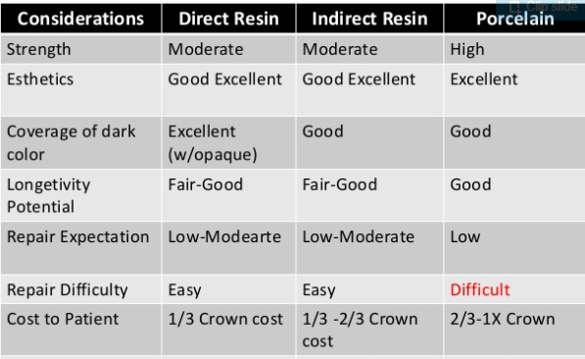

Slide 12
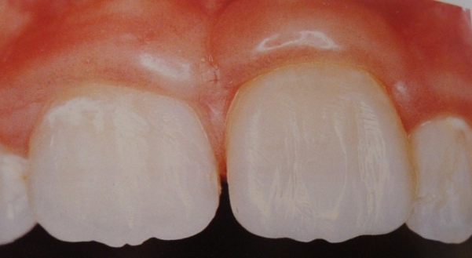
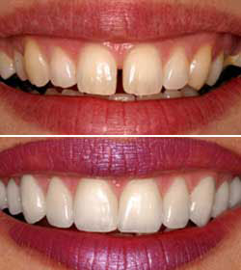
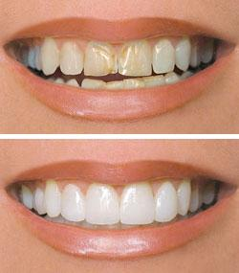
ENDONTICALLY TREATED FRACTURED ANTERIOR TEETH
Indications
DIASTEMA
DISCOLORATION

Slide 13
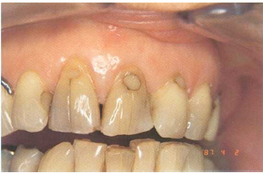
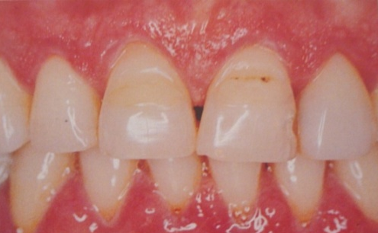
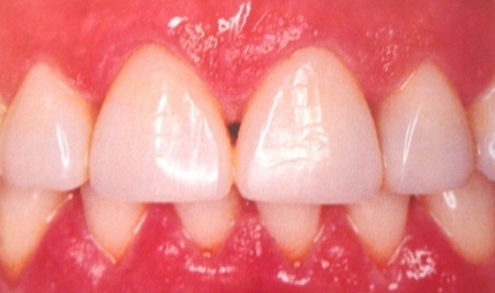
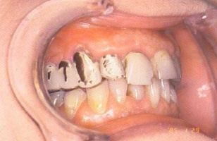
MISSING CENTRAL INCISOR
TOOTH BRUSH ABRASION
WIDE DEFICIENT RESTORATION ON FACIAL SURFACE
BONDING TO EXISTING RESTORATIONS

Slide 14
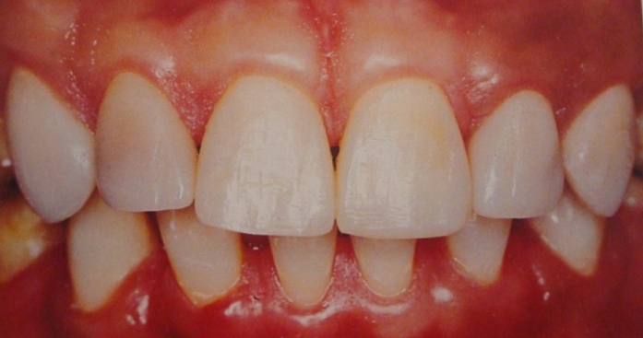
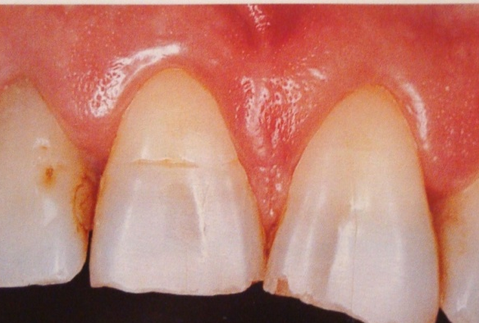
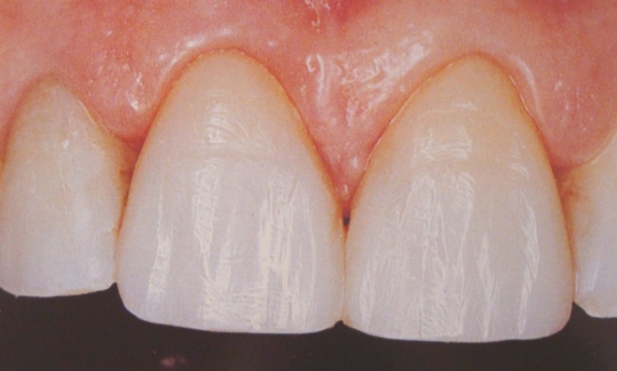
GENERALIZED ENAMEL HYPOPLASIA
DENTAL FLUOROSIS
ABRADED INCISAL REGIONS

Slide 15
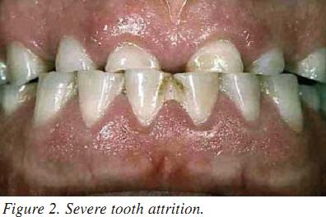
Contraindication
Highly caries index
Bruxism

Slide 16
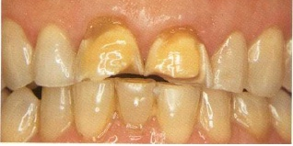
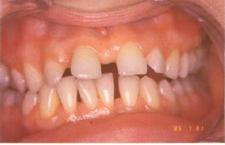
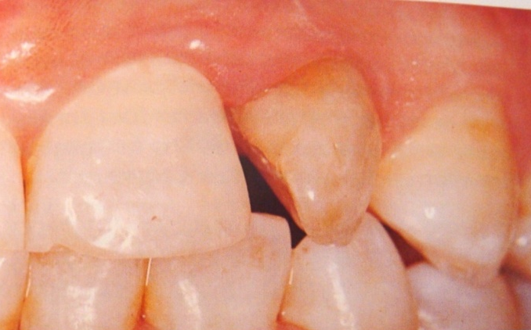
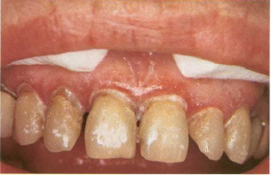
INSUFFICIENT FUSIBLE SUBSTRATE EXCESSIVE INTERDENTAL SPACING
POOR ORAL HYGIENE EXCESSIVELY ROTATED TOOTH

Slide 17
TYPES OF VENEERS
I. Based on the extent of tooth involved,
(i) Partial veneers
(ii) Full veneers
- Window preparation
- Butt joint incisal preparation
- Incisal lapping preparation
II. Based on the type of material employed,
(i) Directly applied composite veneer
(ii) Processed composite veneer
(iii) Feldspathic porcelain veneer
(iv) Pressed ceramic veneer
III. Based on the mode of fabrication,
(i) Direct veneers
- Direct Partial veneer
- Direct Full veneer
(ii) Indirect veneers
- No Prep veneers
- Etched Porcelain veneers
- Pressed Ceramic Veneers

Slide 18
TYPES OF VENEERS
BASED ON SURFACE INVOLVEMENT
TWO TYPES
Partial veneers
Full veneers
Accomplished by direct or indirect technique

Slide 19
PARTIAL VENEER
Facial view of partial veneer that does not extend sublingually or involve incisal angle

Slide 20
Full veneer
Full veneer with window preparation design that extends to gingival crest & terminates at the facio incisal angle
Full veneer with incisal-lapping preparation design extending sublingually that includes all of incisal surface.

Slide 21
Types of preparation
Type I ➔ WINDOW preparation .(feather in which the veneer is taken up to the height of the incisal edge but the edge, is not reduced).
Type II ➔ BUTT-JOINT preparation .( 2 mm incisal reduction without palatal chamfer).
Type III ➔ WRAP (3 – 1 mm incisal reduction with 1 mm height palatal chamfer ).

Slide 22
Procedure for Laminate Veneers tooth preparation
Involves the following steps
Labial Reduction
Proximal reduction
Sulcular Extension
Incisal Reduction
Lingual Reduction.

Slide 23
Type I (window preparation)

Slide 24
Depiction of enamel thickness on the facial aspect of the tooth
THE REDUCTION MUST BE IN :
* Gingival third = 0.3 mm . * Middle third = 0.5 mm . * Incisal third = 0.5 mm .

Slide 25
A 016 round bur is placed at the tip of the gingival papilla and cuts the cervical margin in a counterclockwise direction. The bur shaft is held in contact with the facial aspect of the tooth
1

Slide 26
Using the 016 round bur, the gingival and interproximal margins are placed at the correct depth.
2

Slide 27
Using the cutter depth wheels bur, make a series of different depths at various locations of the facial profile of the tooth
3

Slide 28
a 018 tapered diamond bur , the unprepared enamel islands are removed to the level of the horizontal depth cuts. The reduction follows the facial contour of the tooth.
4

Slide 29
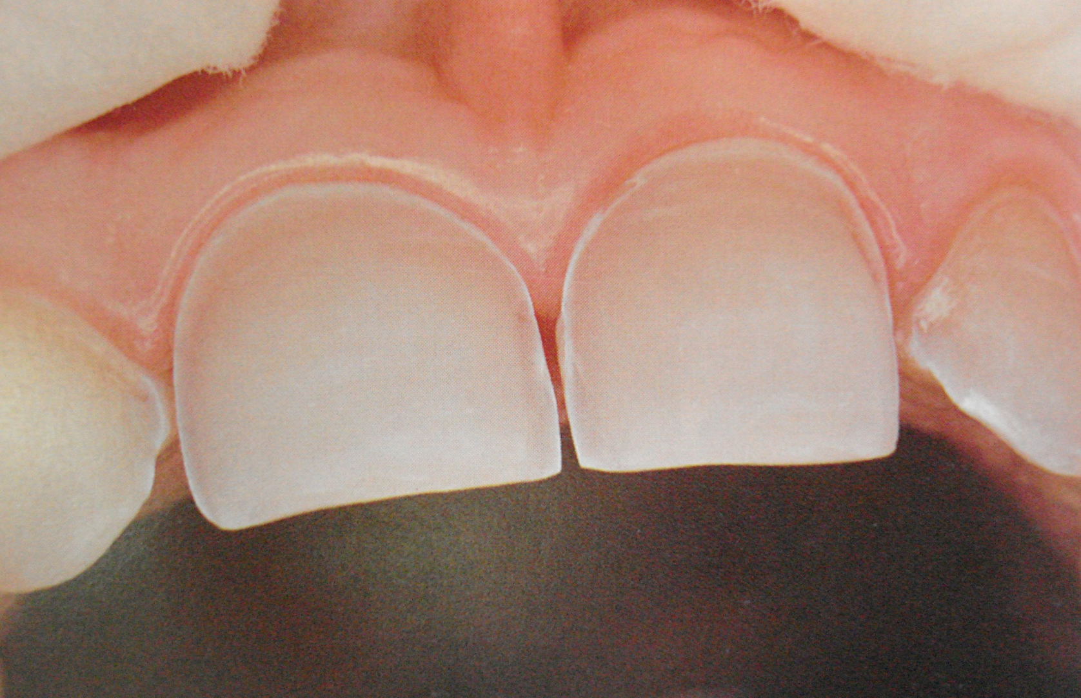
It utilizes minimal tooth preparation mainly confined within enamel. Keeping clear of the gingival margins
5

Slide 30
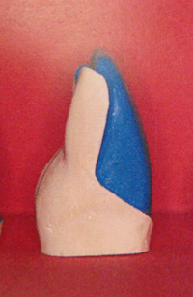
Type II (Butt joint preparation)

Slide 31
BUTT-JOINT INCISIAL DESIGN
A butt-joint incisal design is used routinely in cases where no defects exist along the lingual aspect of the incisal edge.
It is the simplest design and is used to easily provide adequate reduction of the tooth to accommodate the needed strength of the porcelain veneer in this area of the preparation.

Slide 32
1
In type2 laminate veneers we begin as type I but incisel reduction is involved with a 1.5 to 2 mm (butt joint).

Slide 33
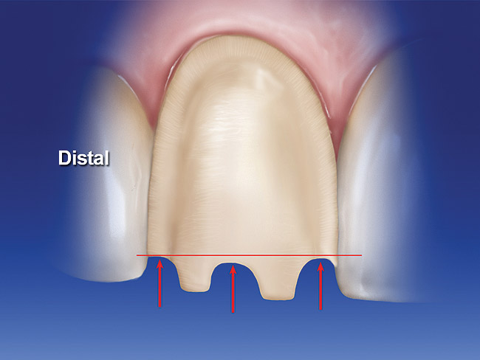
2
A 2 mm incisal reduction without palatal chamfer [butt joint] is prepared .
The arrows show the level of the incisal depth cuts. The distal depth cut is the most gingivally positioned, followed by the mesial and then the center depth cuts.

Slide 34
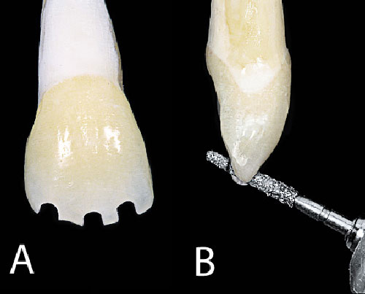
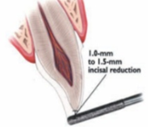
3
Reducing the incisel edge with a round or flat tapered ended bur.

Slide 35
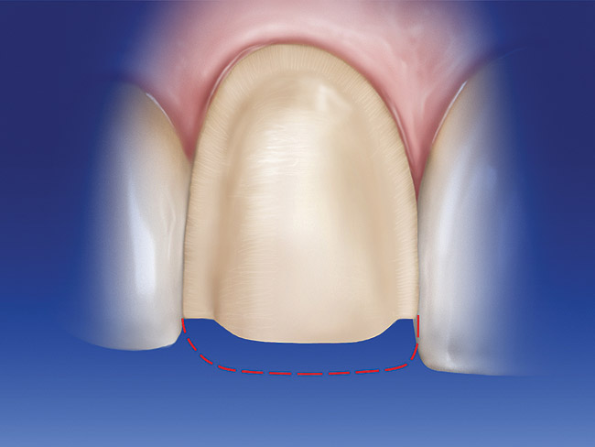
4
The incisal depth cuts are connected creating a uniform reduction that follows the original curvature of the incisal edge.

Slide 36
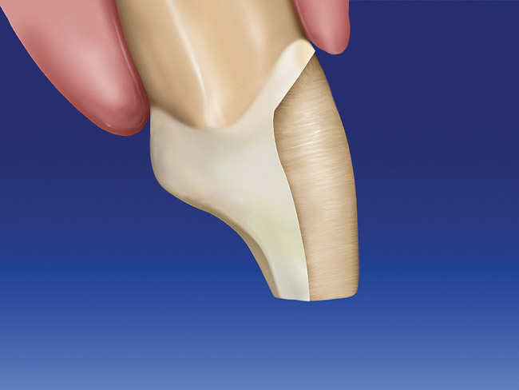
5
Lateral view of prepared tooth

Slide 37
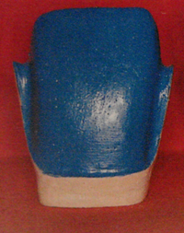
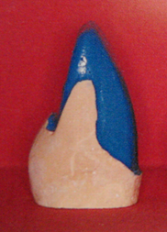
Type III (wrap around)

Slide 38
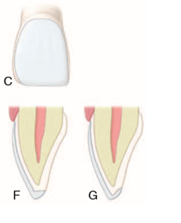
Incisal-lapping Preparation
Indicated when the tooth being veneered needs lengthening or when an incisal defect warrants restoration.
The extent of the lapping onto the lingual surface is generally dictated by the extent of the lingual incisal defect or by the amount of faciolingual resistance form desired for reinforcement of the incisal edge.

Slide 39
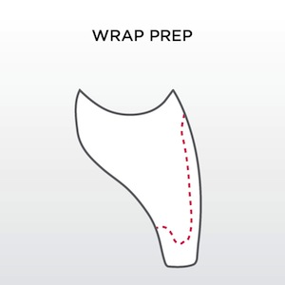
1
It restricts angle fractures. When the free edge is not overlaid, the occlusal third of the laminates are very thin ( less than 0.3 mm) and liable to fracture. It enhances esthetic properties of laminates.

Slide 40
2
Type III preparation includes labial and palatal reduction which is distinguished from Type I & II .

Slide 41
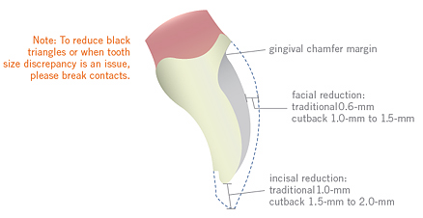
3
1 mm incisal reduction with 1 mm height palatal chamfer.

Slide 42
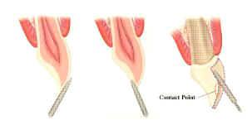
4
A reduction is reduced with a rounded or flat ended bur.

Slide 44
PROCEDURE STEPS
Shade selection
Preliminary tooth modification
Tooth preparation
Provisional restoration
direct method
indirect method
Laboratory procedures

Slide 45
NO-PREP VENEERS
One approach being used for indirect veneers is to place them on teeth with no tooth preparation. Although this “no prep” approach may at first appear desirable, it can later cause problems if proper case selection is not done.
INDICATIONS
When teeth are inherently under contoured.
When interdental spaces or open incisal embrasures are present or both.

Slide 46
DISADVANTAGES
No-prep veneers are inherently made thinner and consequently are more prone to fracture, especially during the try-in phase.
Indirect no-prep veneers, interproximal areas are difficult to access for proper finishing.
If case selection is not done properly and the teeth are already of normal contour, the resulting veneers inevitably will be over contoured. Veneers that are over contoured are not generally esthetic and often can result in impingement of gingival tissue.

Slide 47
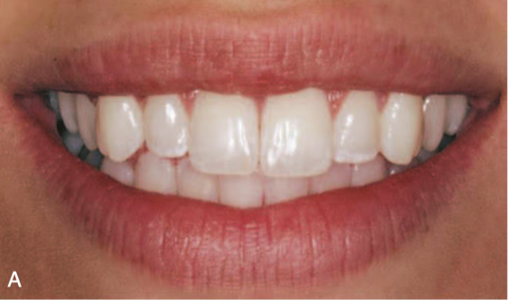
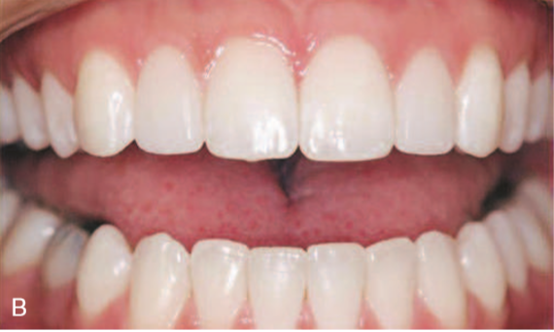

Slide 48
FAILURES
Mechanical
Biological
Aesthetics

Slide 49
REPAIR OF VENEERS
Failures of aesthetic veneers occur because of breakage, discoloration, or wear. Consideration should be given to conservative repairs of veneers if the examination reveals that the remaining tooth and restoration are sound.
To repair porcelain veneers, a hydrofluoric acid gel, suitable for intraoral use (but only with a rubber dam in place), must be used to etch the fractured porcelain.
Hydrofluoric acid gels are available in approximately 10% buffered concentrations that can be used for intraoral porcelain repairs if proper isolation with a rubber dam is used.

Slide 50
Isolation of the porcelain veneer to be repaired should always be accomplished with a rubber dam to protect gingival tissue from the irritating effects of the hydrofluoric acid.
The manufacturer’s instructions must be followed regarding application time for the hydrofluoric acid gel to ensure optimal porcelain etching.
A lightly frosted appearance, similar to that of etched enamel, should be seen if the porcelain has been properly etched.
A silane coupling agent may be applied to the etched porcelain surface before the adhesive is applied.
Composite material is added, cured, and finished in the usual manner.
Large fractures are best treated by replacing the entire porcelain veneer.

Slide 51
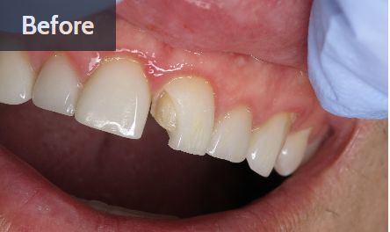
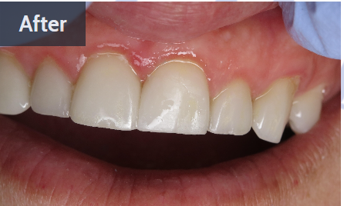
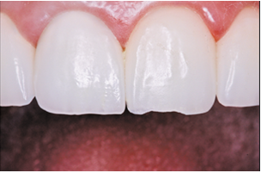
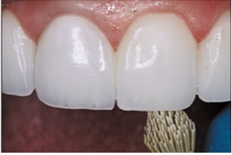

Slide 52
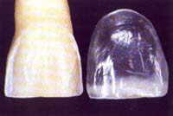
RECENT ADVANCES
Lumineers
Features
Main feature is they are made of ultra thin thickness.
Thickness is 0.2-0.3mm.
Placed using either
NO PREPARATION or MINIMAL CONTURING TECHNIQUE

Slide 53
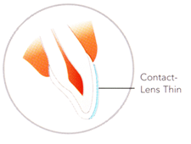
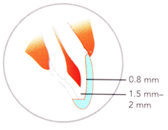
Advantages:
No need to reduce tooth structure.
Allows preservation of natural tooth structure.
No anesthesia is required.
No teeth sensitivity.
Traditional Prep Veneers
Contact-lens-thin Lumineers

Slide 54
Over the years there have been various advancements in laminates and veneers in dentistry
Stacked/feldspathic teeth veneers
Thick monochromatic teeth veneers
Teeth veneers with reinforced leucite
Lithium disilicate teeth veneers
Durathin veneers
Vivaneers
Da Vinci veneers

Slide 55
CONCLUSION
This procedure is becoming more common in dental offices because everyone wants a great smile
It is a great way to change a smile that shows yellowed, stained teeth into one that makes you look fantastic.
But remember veneers are not for everyone, and if your teeth are not strong enough you will not be recommended to have the dental veneers applied

