Slide 2
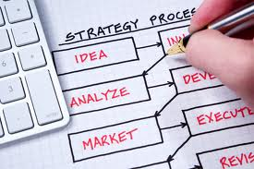
PLANNING AND EVALUATION
DR. V. SIVA KALYAN REDDY
READER
DEPT.OF PUBLIC HEALTH DENTISTRY

Slide 4
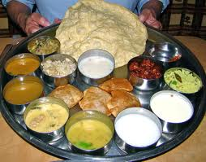
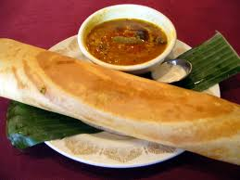

Slide 5
DEFINITION
“A PLAN IS A DECISION ABOUT A COURSE OF ACTION.” - E.C.BANFIELD

Slide 6
DEFINITION
A Plan Is
A Systemic Approach To
Defining The Problem,
Setting Priorities,
Developing Specific Goals, and
A Method Of Implementation.”

Slide 7
DEFINITION
“The Orderly Process Of
Defining Community Health Problems,
Identifying Unmet Needs And
Surveying The Resources To Meet Them,
Establishing Priority Goals That Are Realistic And Feasible And
Projecting Administrative Action To Accomplish The Proposed Programme.”

Slide 8
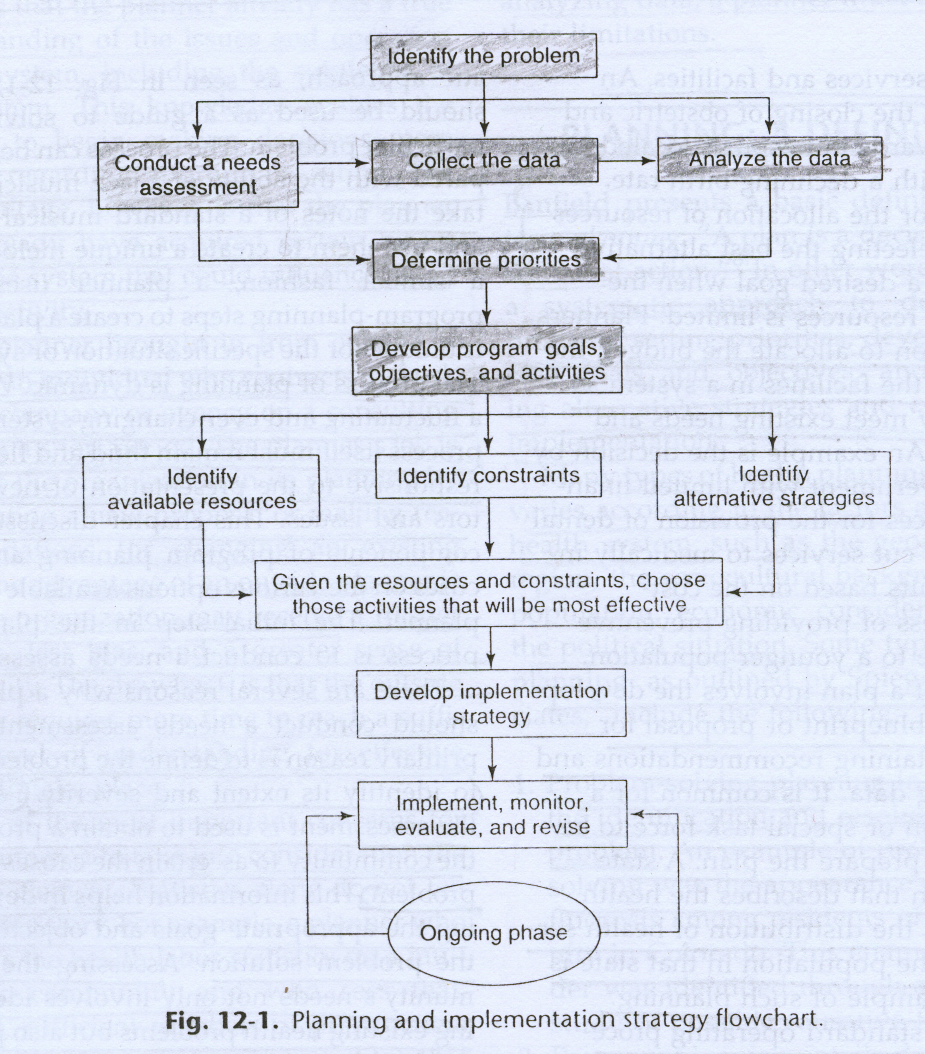

Slide 9
1. CONDUCT A NEEDS ASSEMENT
The primary reason is to define the problem and to identify its extant and severity.
Second , it is used to obtain a profile of the community to ascertain the causes of the problem , which helps in developing the appropriate goals and objectives in the problem solution.

Slide 10
2. COLLECTION OF DATA
Number of individuals in the population
Geographic distribution of population
Rate of growth
Population density and degree of urbanization
Ethnic background
Diet and nutritional levels
Standard of living ,including types of housing
Amount of public services and utilities.
Public and private school system.
General health profile.
Patterns and distribution of dental disease.

Slide 11
2. COLLECTION OF DATA
HISTORY AND CURRENT STATUS OF DENTAL PROGRAMS IN THE COMMUNITY BY ASKING:-
What types of programs currently exist?
Are there programs oriented toward prevention, treatment, education ,research or combination?
How successful have those responsible been?
We should enquire about policies and decisions made within community by enquiring about
financial leaders .? Political leaders?
Who sets the policies for the community?

Slide 12
3. ANALYZE THE DATA

Slide 14
4. DETERMINING PRIORITIES
Preschool& school age children.
Mentally or physically disabled persons.
Chronically ill or medically compromised persons.
Elderly persons.
Expectant mothers.
Low income minority groups. (Urban & rural)

Slide 15
5.DEVELOPMENT OF GOAL AND OBJECTIVES
The stated objectives should satisfy 3 requirements
They must meet the purpose of study.
They should be phrased clearly- unambiguously and very specifically.
Should be realistic and formulated in operational terms.

Slide 16
6. RESOURCE IDENTIFICATION
Appropriateness: the most suitable resources to get the job done
Adequacy : the extent or degree to which the resources would complete the job.
Effectiveness: how capable the resources are at completing the job.
Efficiency: the cost and amount of time expended to complete the job.

Slide 17
7. IDLENTITYING CONSTRAINTS

Slide 18
8. IDENTIFYING STRATEGIES (ALTERNATIVE STRATEGIES)

Slide 19
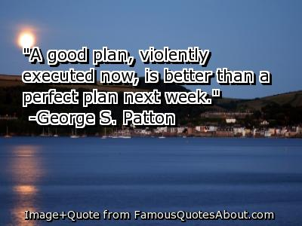
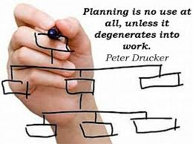

Slide 20
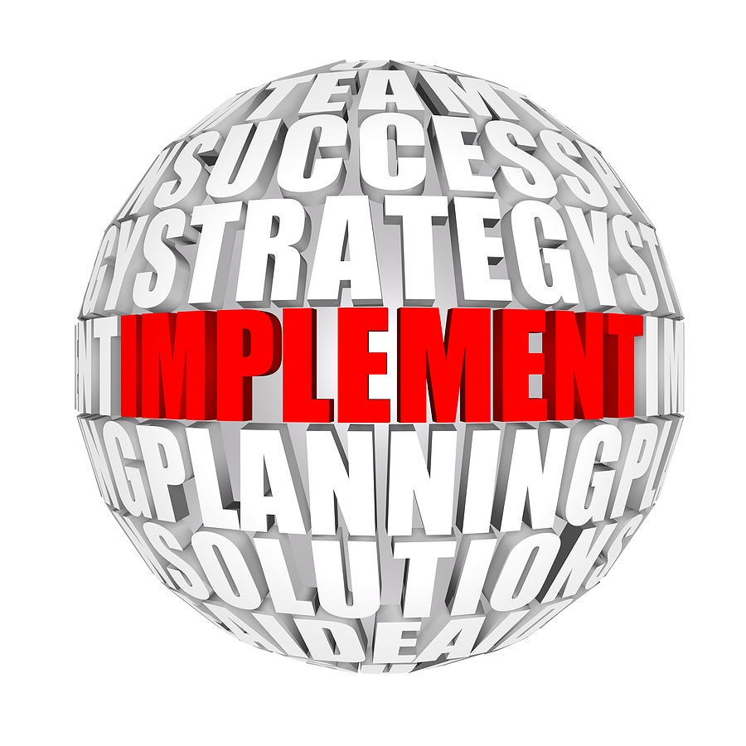
9.DEVELOPING AN IMPLEMENTATION STRATEGY

Slide 21
RULES FOR IMPLEMENTATION

Slide 22
RULES FOR IMPLEMENTATION

Slide 23
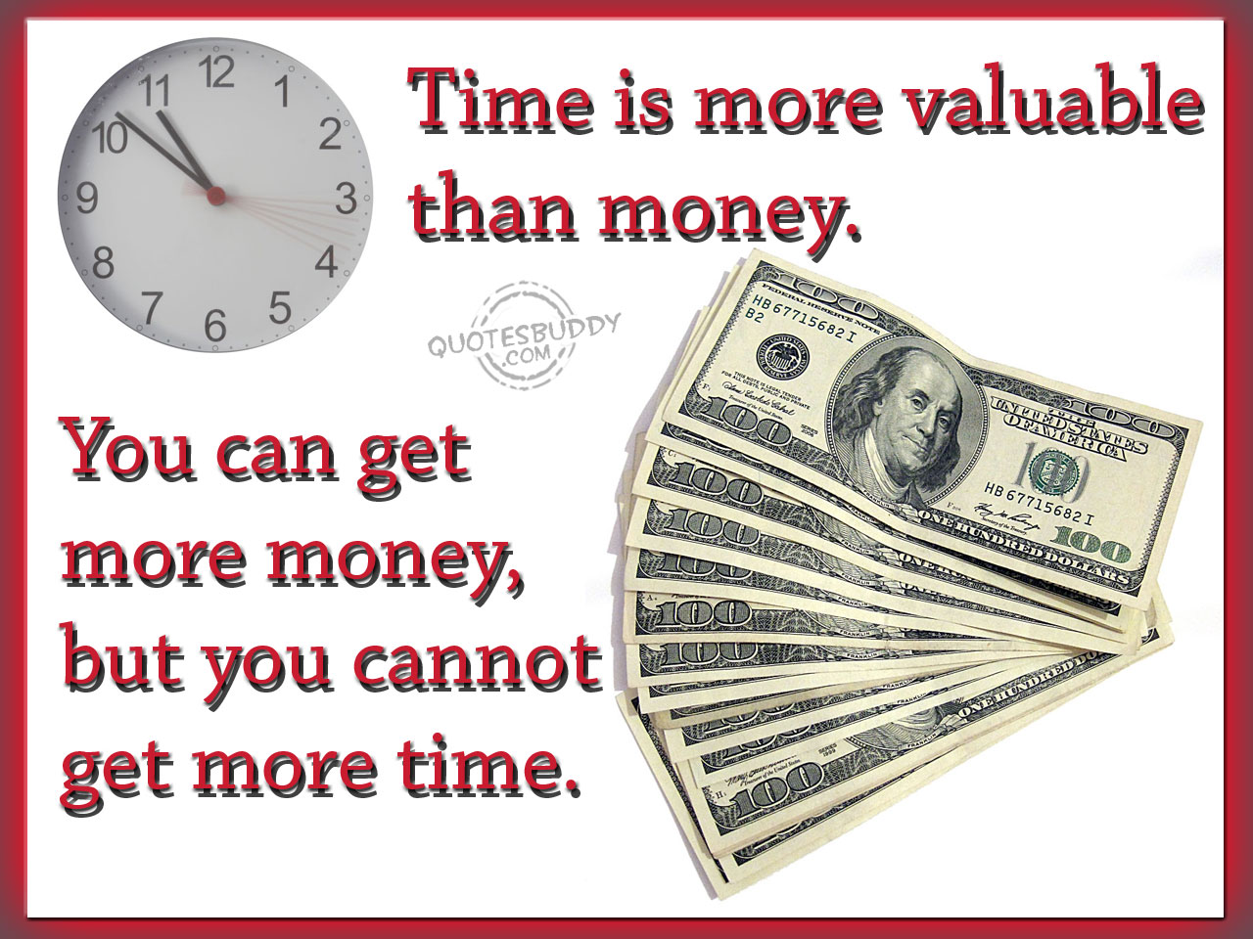
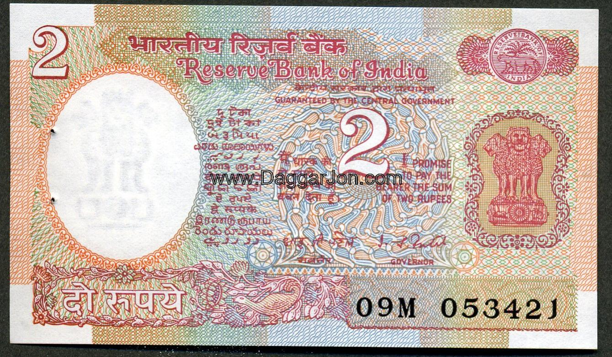
RULES FOR IMPLEMENTATION

Slide 24
10. MONITORING , EVALUATING& REVISING THE PROGRAM

